Slide 1
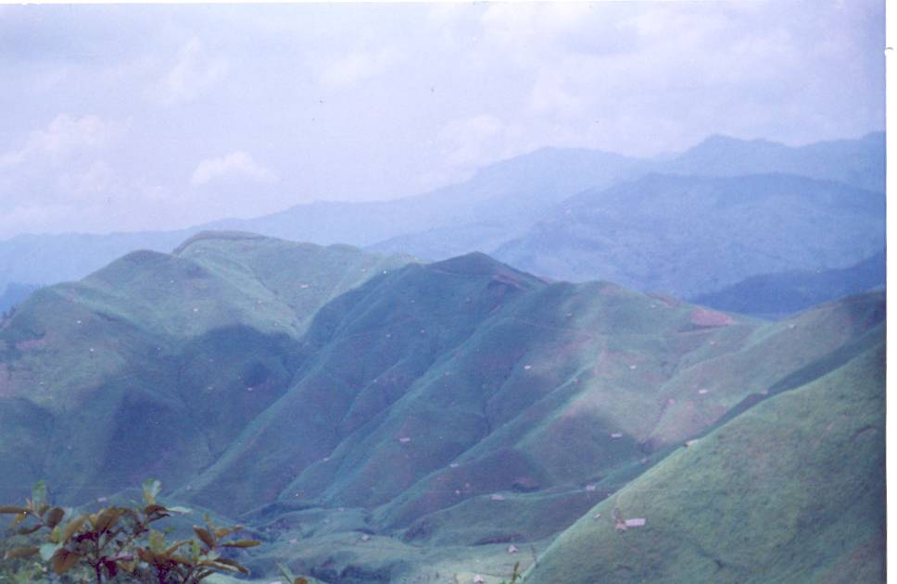
Dr Akali Sema
Prof. & Head
Department of Horticulture
School of Agricultural Sciences & Rural Development
Nagaland University , Medziphema – 797 106
akali_chishi@yahoo.co.in
+919436262348
Local Governments and the Promotion of Bio- villages
W E L C O M E T O N A G A L A N D

Slide 2
NORTH EAST INDIA………………………………….
NORTH EAST INDIA
Arunachal Pradesh
Sikkim
Assam
Nagaland
Meghalaya
Manipur
Tripura
Mizoram

Slide 3
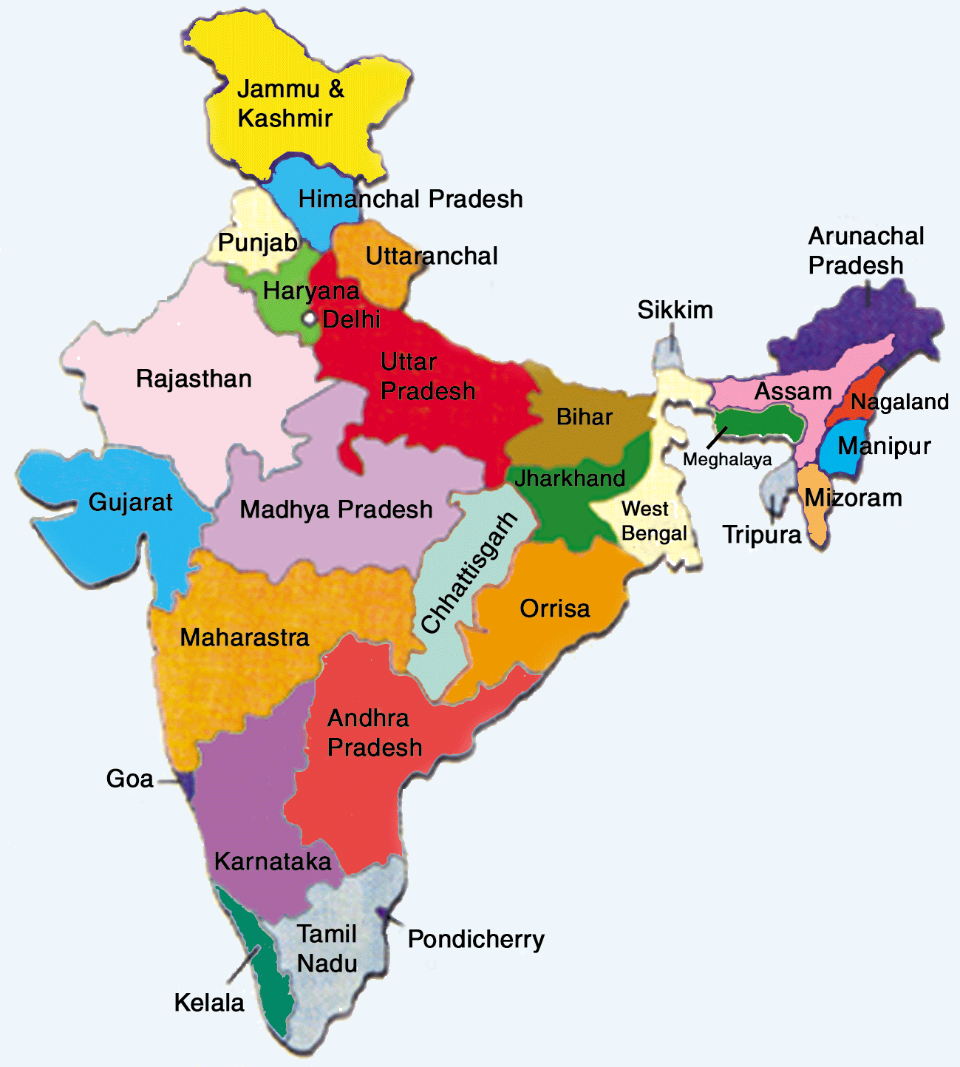
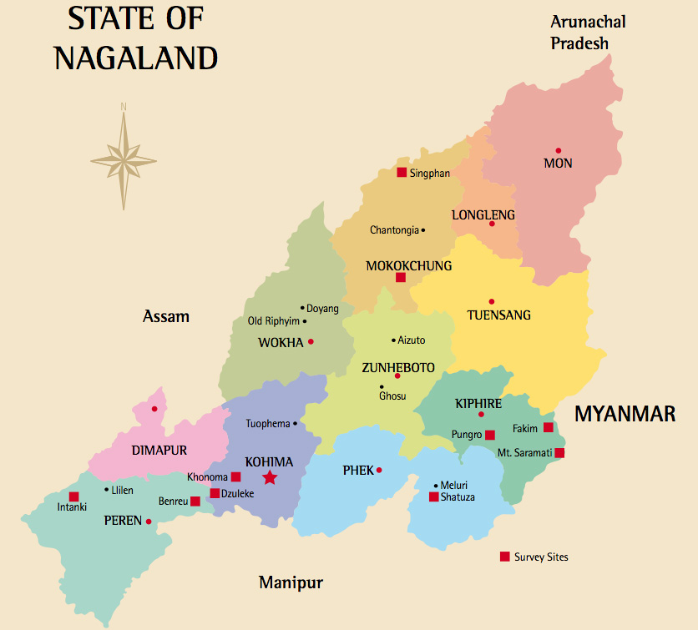

Slide 4
BIO VILLAGE – SBN
IDEA CONCEIVED – CIH, Nagaland
CONCEPTUALISED – ICCOA, Bangalore
FUNDED – North East Council (NEC) ,Govt. of India
IMPLEMENTED – State Horticulture Dept. Govt of Nagaland
VILLAGE SELECTED – MOLVOM ,DIMAPUR ,NAGALAND
SATELLITE VILLAGES- Bunsang , Razephema, Bade

Slide 5
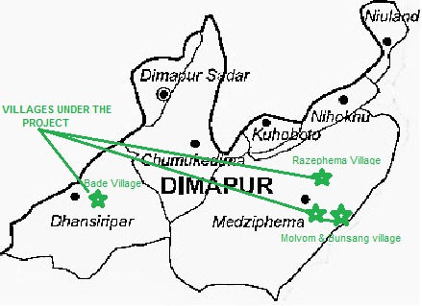
VILLAGES UNDER BIO- VILLAGE PROJECT

Slide 6
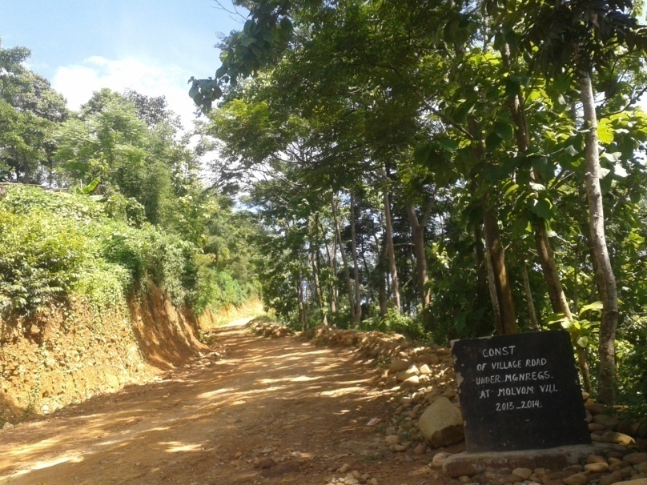
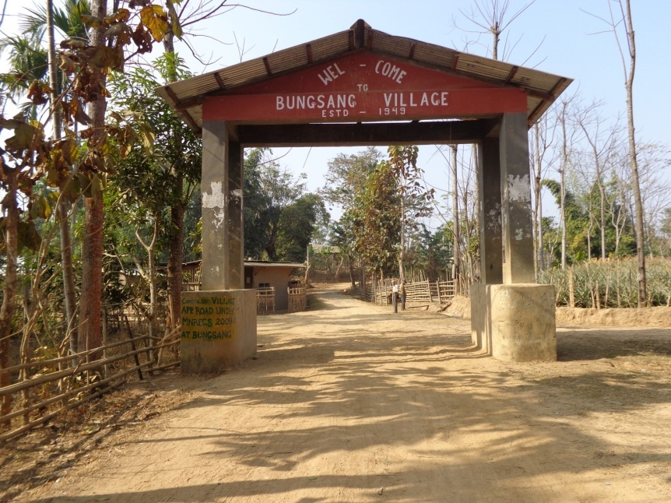
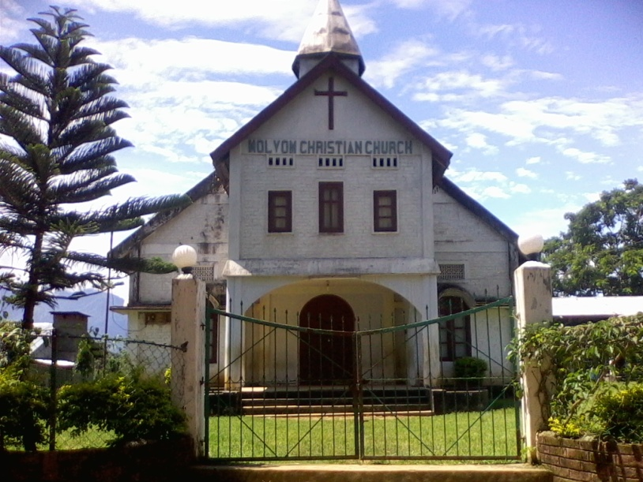
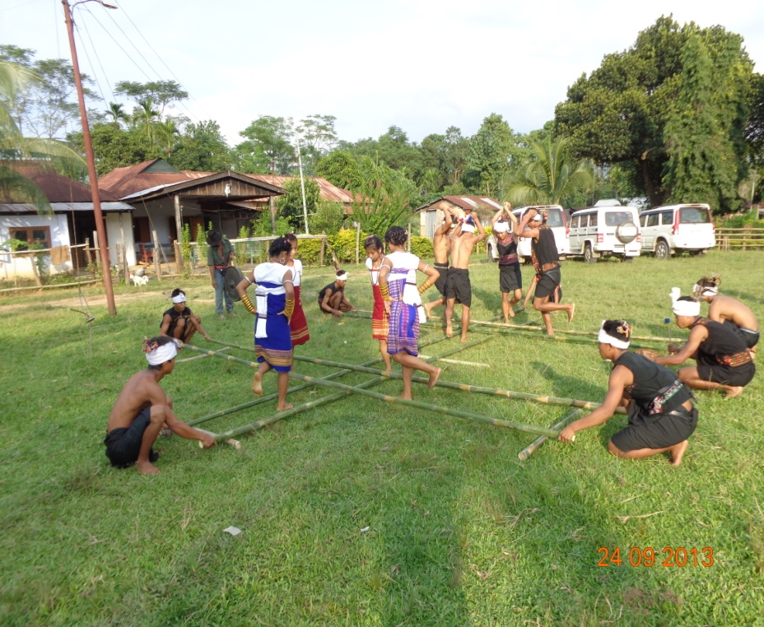
BIO VILLAGES
BIOVILLAGES- a glimpse

Slide 7
BIO VILLAGE – CONCEPT
BIOVILLAGE
An ideal model of sustainability, community dev., environmental sanctuary & eco. well-being of farmers / village.
A model for dev. of rural & resource poor areas
Promote efficient & sustainable use of natural & human resources.
Emphasis on appropriate, eco-friendly & resource- conserving technologies that improves the livelihoods & help in emergence of local enterprises.

Slide 8
BIO VILLAGE
BIOVILLAGE
Aims at systematic utilization and integration of natural and human resources in villages, using a cluster mode approach for socio-economic dev. in rural areas.
Envisaged to integrate many components of developments necessary to make a village self-reliant, sustainable & improve livelihood of its community.

Slide 10
-
INTEGRATION OF SEVEN COMPONENTS
Agriculture/Horticulture
Animal husbandry
Organic input production
Biogas units
Processing & Value addition
Rural entrepreneurship
Agri and Eco-tourism

Slide 11
AGRICULTURE / HORTICULTURE
AGRICULTURE /HORTICULTURE
Main crops : Paddy / pineapple / Turmeric / Ginger
( 1200 ha )
Various interventions: State Govt. Dept. / CIH/ICAR /ICCOA
Organic adoption & Certification
Capacity building
Market linkage

Slide 12
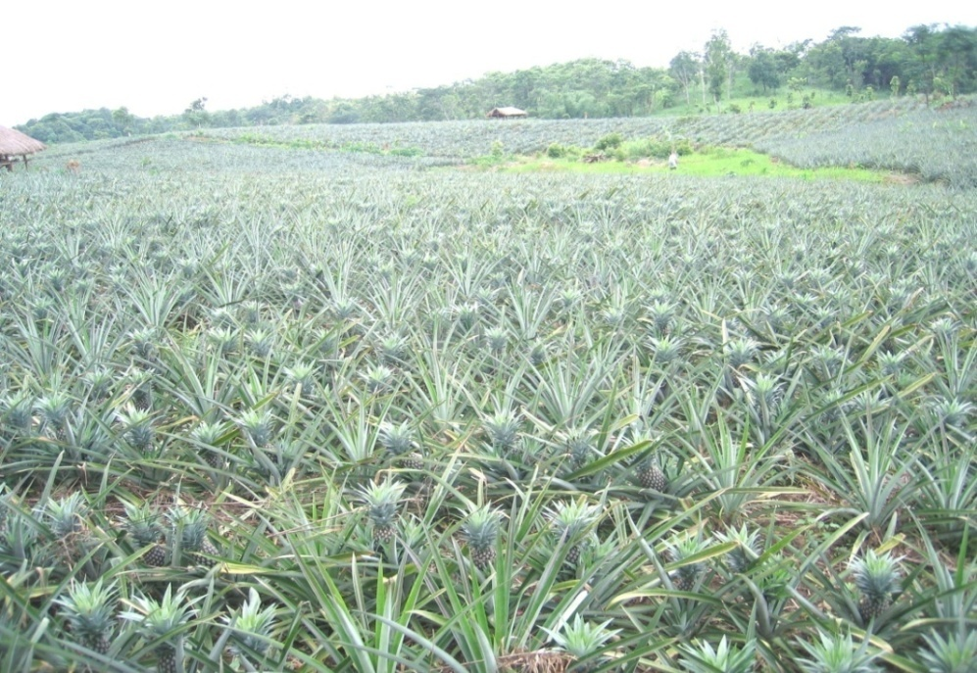
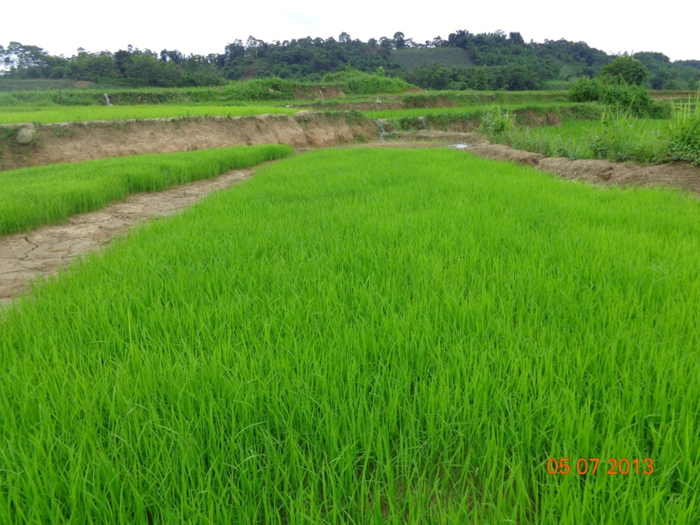
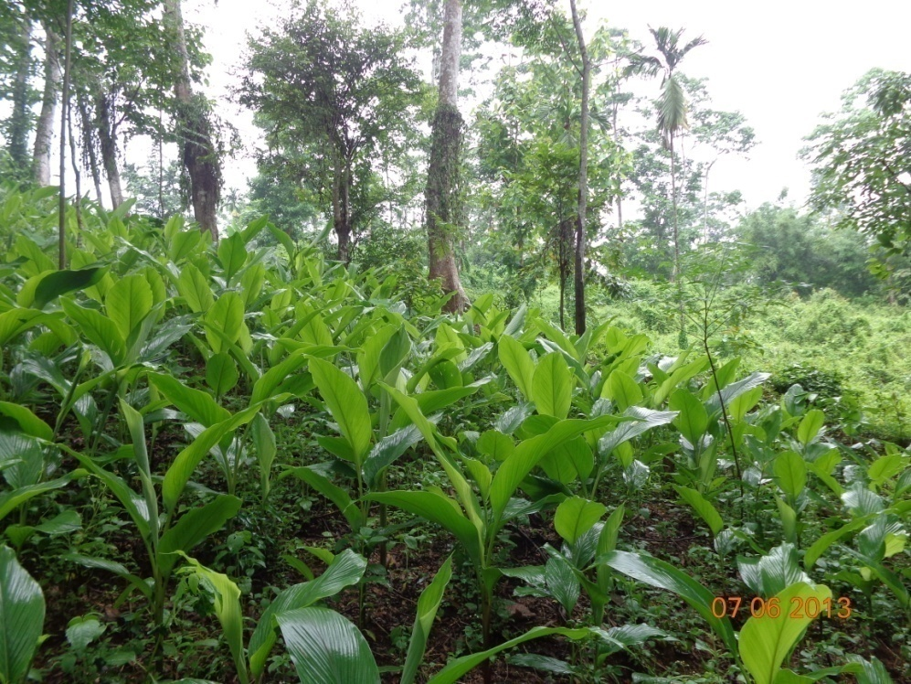
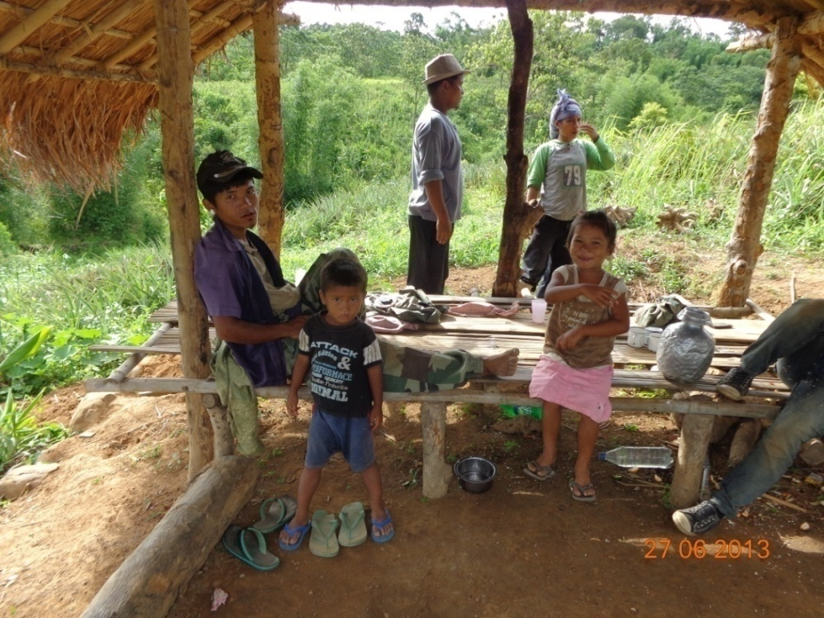
Agri/Horti CROP PRODUCTION

Slide 13
ANIMAL HUSBANDRY
ANIMAL HUSBANDRY
Dairying: For compost production & also as a source of bio agents for pest & diseases management.
( Besides milk & meat)
Piggery : For manure production & good sources of meat.
Poultry : Addl. income & poultry litter as good organic input.

Slide 14
ORGANIC INPUT PRODUCTION
ORGANIC INPUT PRODUCTION
Organic input crucial for sustaining soil fertility
key feature : community based organic input productions – As an enterprise
Farmers and rural youth encouraged, trained & supported to set up input prod. units - entrepreneurship model
Not only for input availability but also trigger a long-term sustainable rural employment & empowerment at village-level.

Slide 15
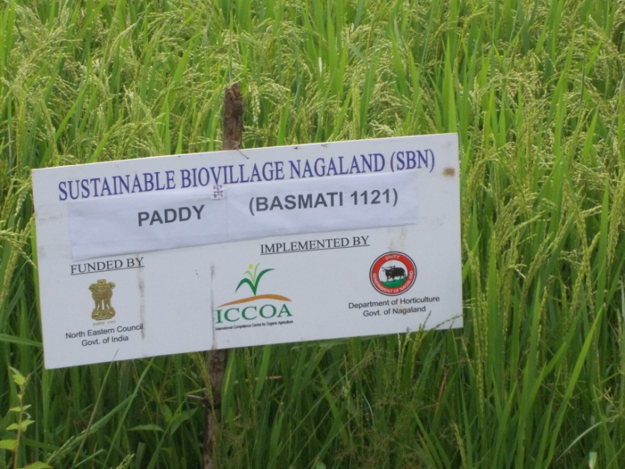
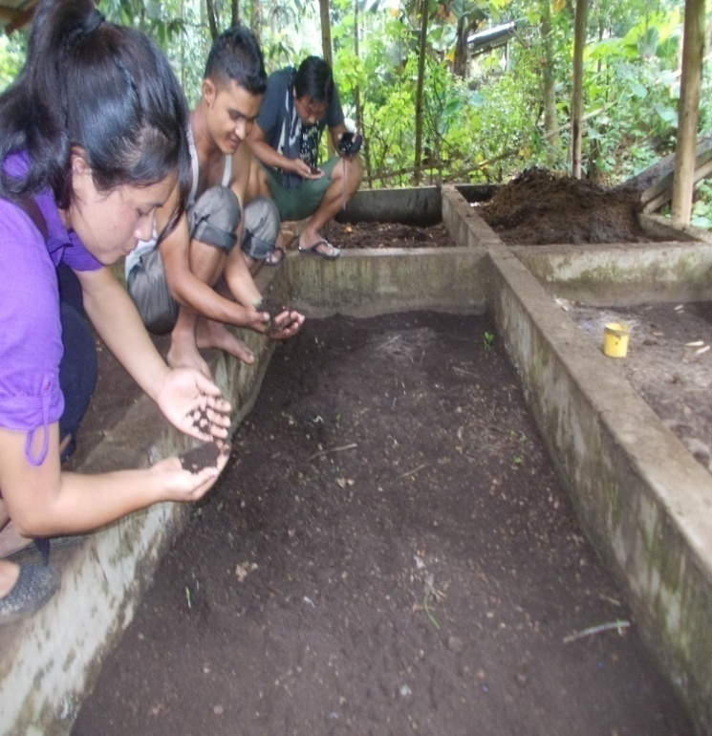
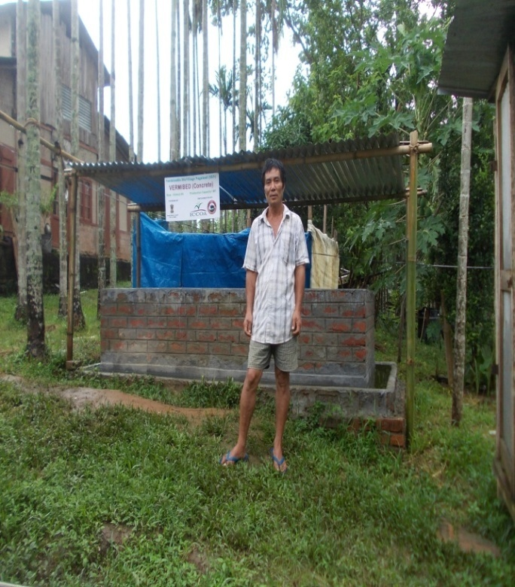
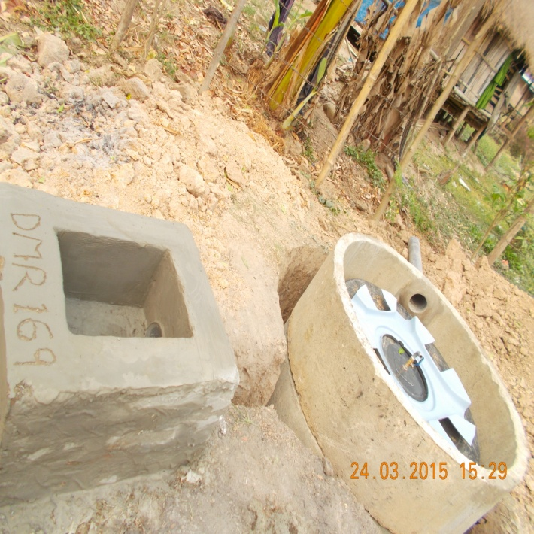
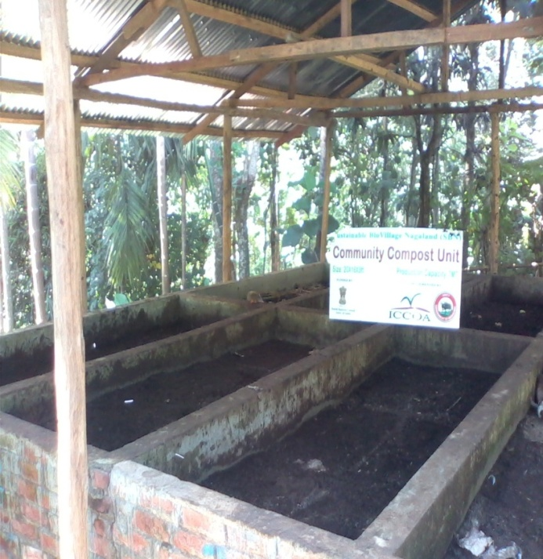
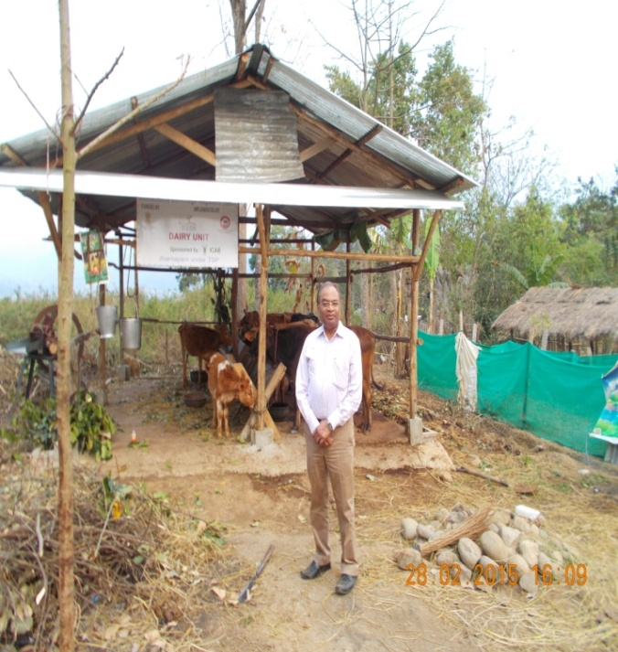
INTERVENTIONS

Slide 16
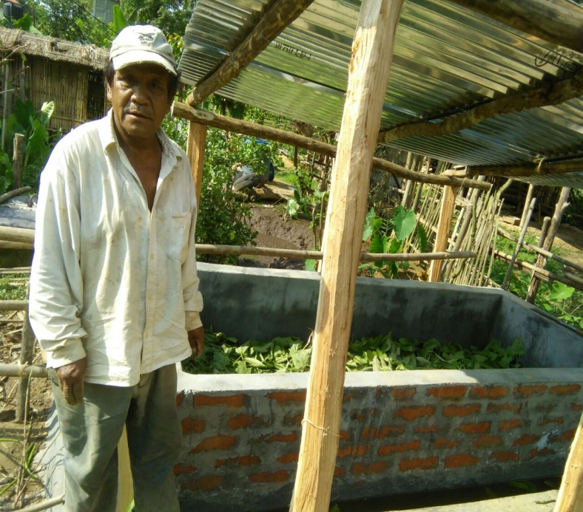
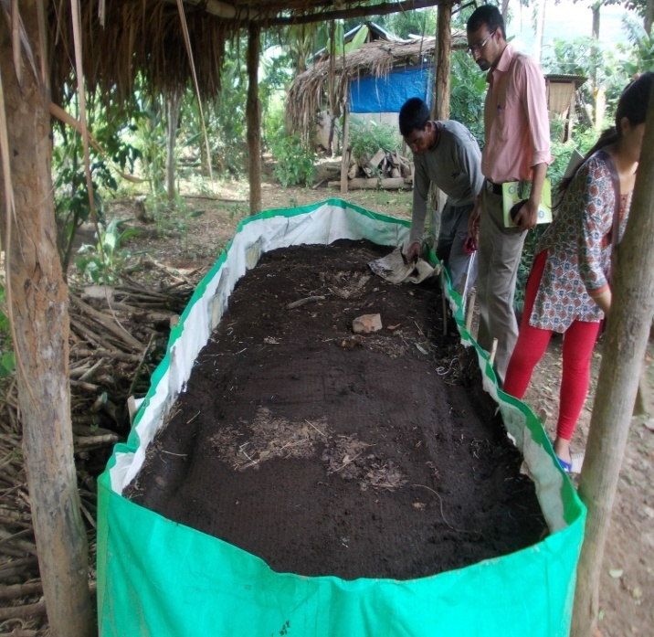
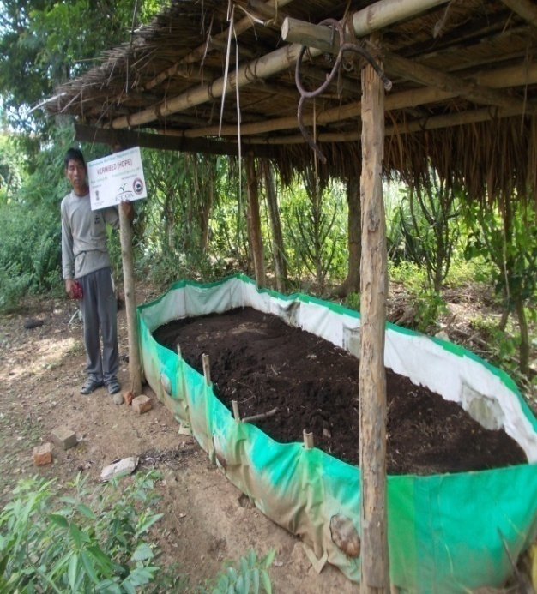
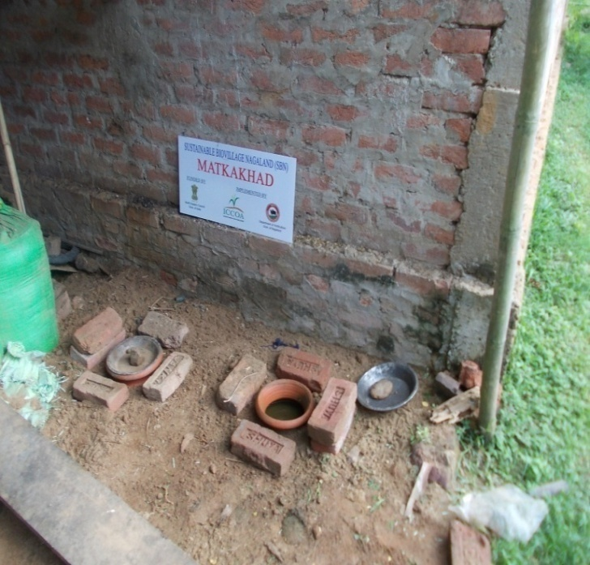
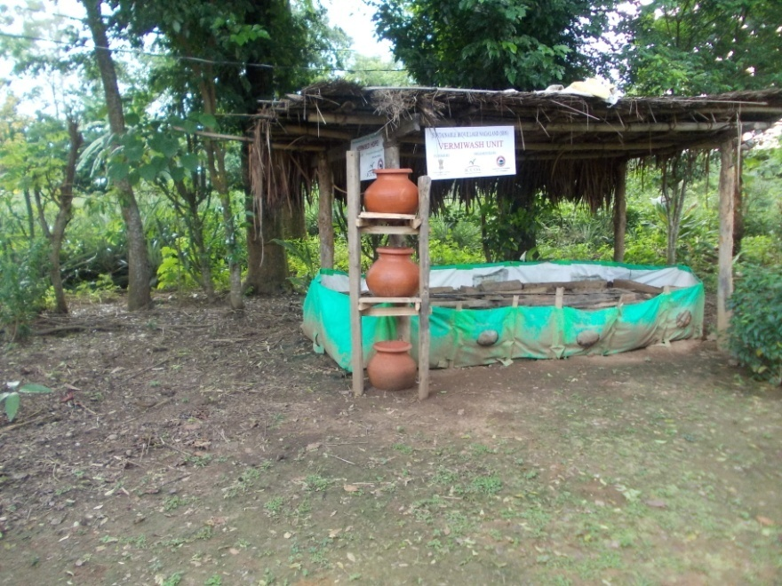
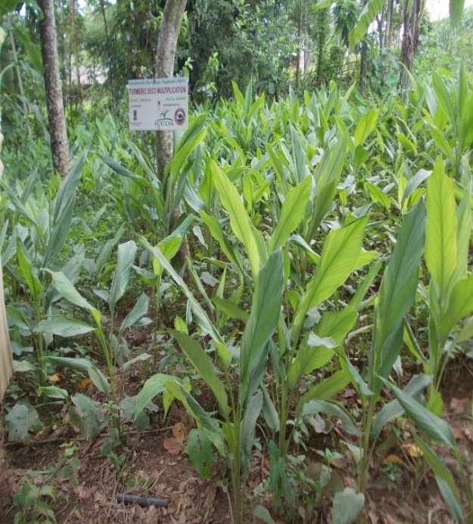

Slide 17
BIOGAS UNITS
BIOGAS UNIT
Few units either with progressive farmers or on a community basis.
Set up alongside the diary unit with cattle dung available at site.
Not only generate bio-gas for kitchen but also provide slurry for fields.

Slide 18
PROCESSING & VALUE ADDITION
PROCESSING & VALUE ADDITION
Concept of Bio village is complete when it has a facility for value addition of produce at village-level itself.
Very impt. where logistics are big challenge & produce in its primary form do not fetch good prices.
Village level integrated pack-house with facilities for collection, pre-cooling , primary processing / value addition and storage

Slide 19
RURAL ENTREPRENEURSHIP
RURAL ENTERPRENEURSHIP
Models for providing gainful employment to its youth
Help in reducing youth moving out of village
Very impt. that rural centers develop - crucial part of ‘inclusive growth ’.
Youth from villages identified, trained & supported
Various Govt. support schemes - integrated efficiently for overall developement

Slide 20
AGRI & ECO-TOURISM
AGRI & ECO –TOURISM
Opportunity for growth, especially in NE states like Nagaland - offers a tourist destination.
Eco-tourism, Agri-tourisms & home-stays - high-end tourists wishing for different experiences.
‘Bio village’ with concepts integrated & with best pineapples available during peak holiday season (June-Aug & also Nov.-Dec-Jan ) will be a rare attraction.
Such Agro-eco tourism promoted in the village –in turn will enhance the farmers’ income & livelihood avenues.

Slide 21
VILLAGES COVERED
VILLAGES COVERED
Molvom : pineapple village of Nagaland
Estd: 1940 , population - 1418. Total area -2100 ha
Cultivated area -1,100 ha, Main crops : pineapple , paddy, veg., citrus.
Impt. economic activity :pineapple cultivation
Farmers soc. formed : 2001
Organic adoption & certification prog.: 2008-09.
Nagaland Organic Pineapple Farming- video.flv
Bunsang: ( Pineapple) Estd : 1949 , population: 1035.
Bade : ( turmeric ) Estd : 1979, population : 800
Rüzaphema ( Paddy) Estd.: 1984 , population : 700

Slide 22
LOCAL GOVERNANCE
GB
(Letjahao Misao)
Council Chairman
(Letjang Hmar)
Chonmang Limson
Lalzon Misao
Lalsat Misao
Hellal Lupheng
Paokam Limson
Kimneiting Hangsing
Jonah Vaiphei
Council Members
(7)
VDB Secretary
(Letthang Misao)

Slide 23
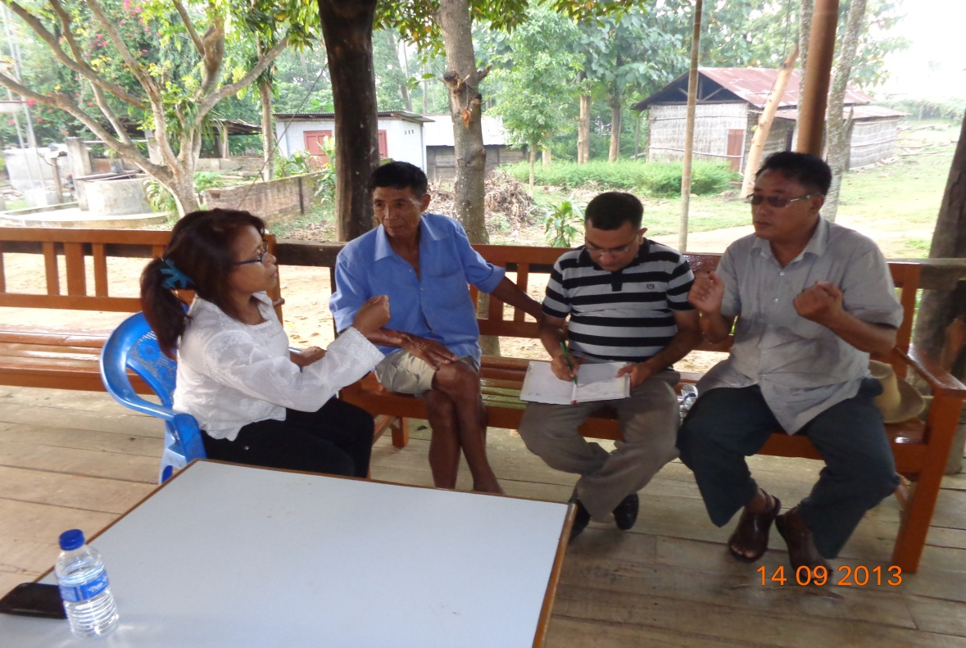
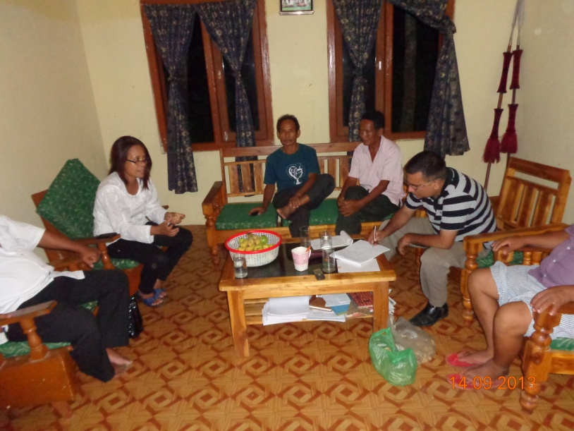
Meetings with Village leaders
Work Plan with farmer leaders

Slide 24
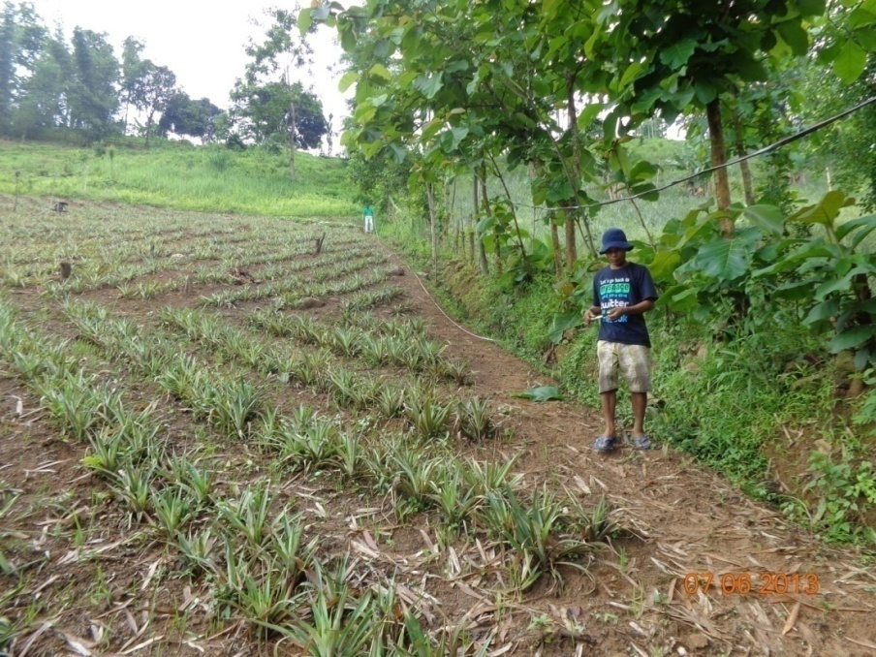
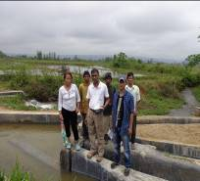
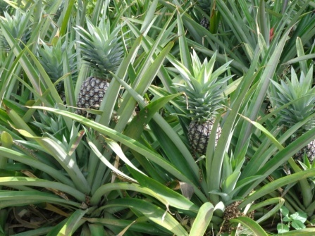
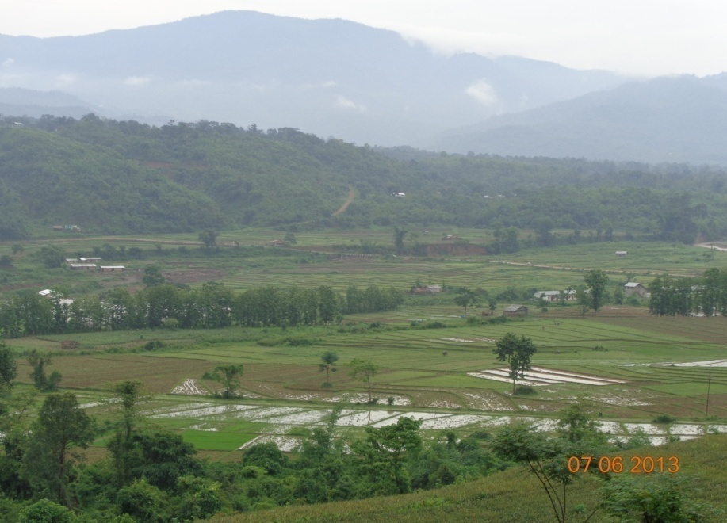
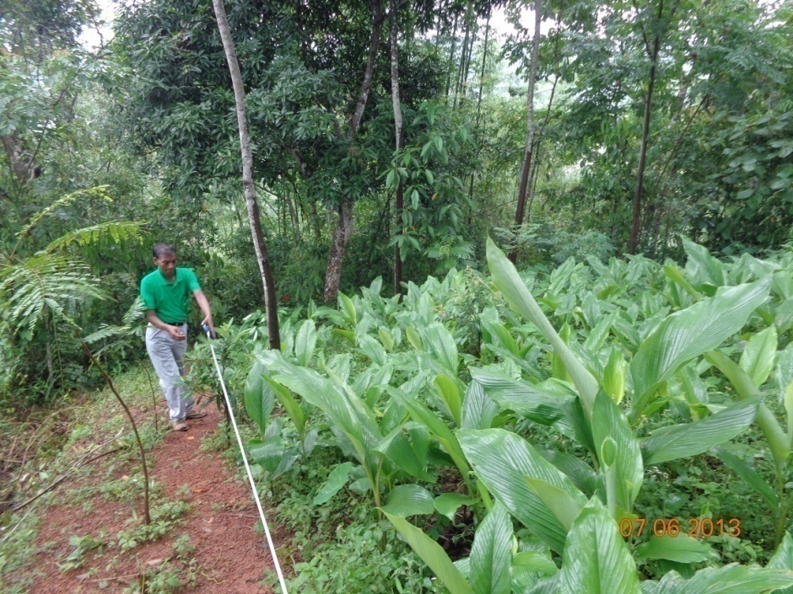
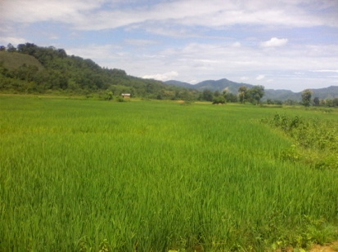
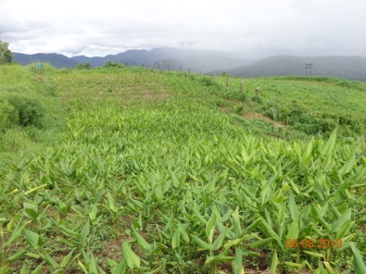
SURVEY OF FARMS

Slide 25
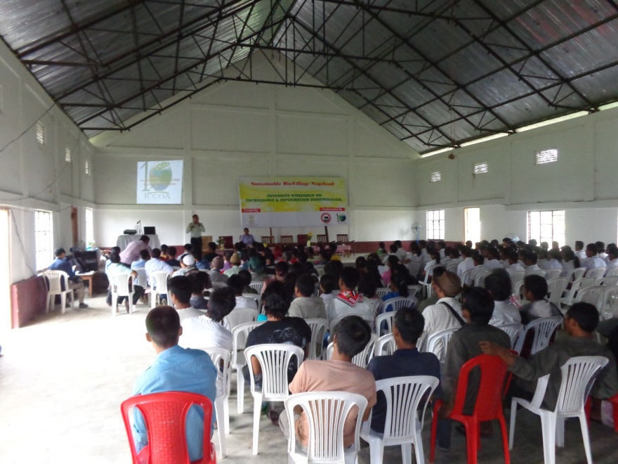
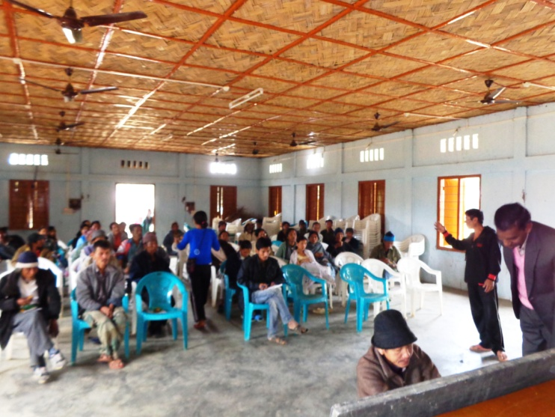
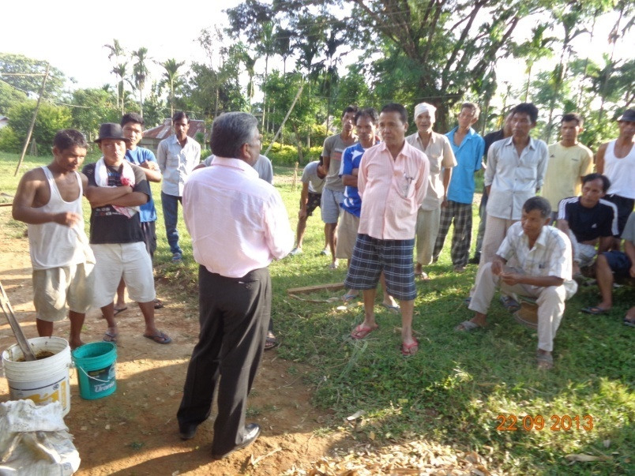
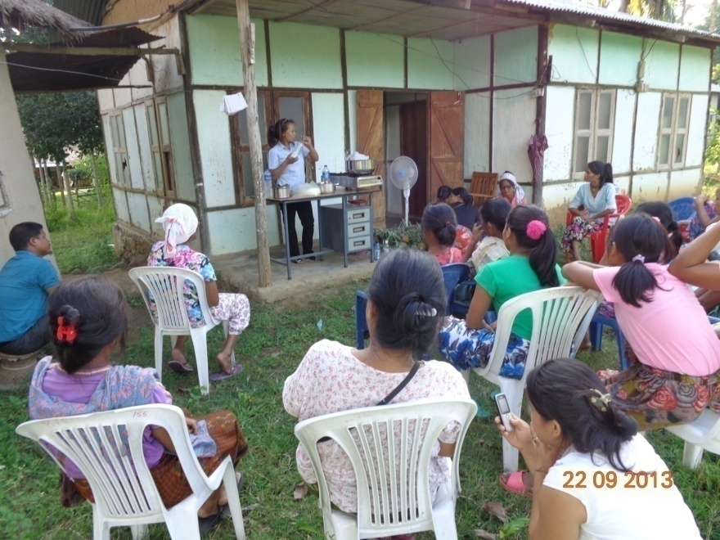
CAPACITY BUILDING OF FARMERS

Slide 26
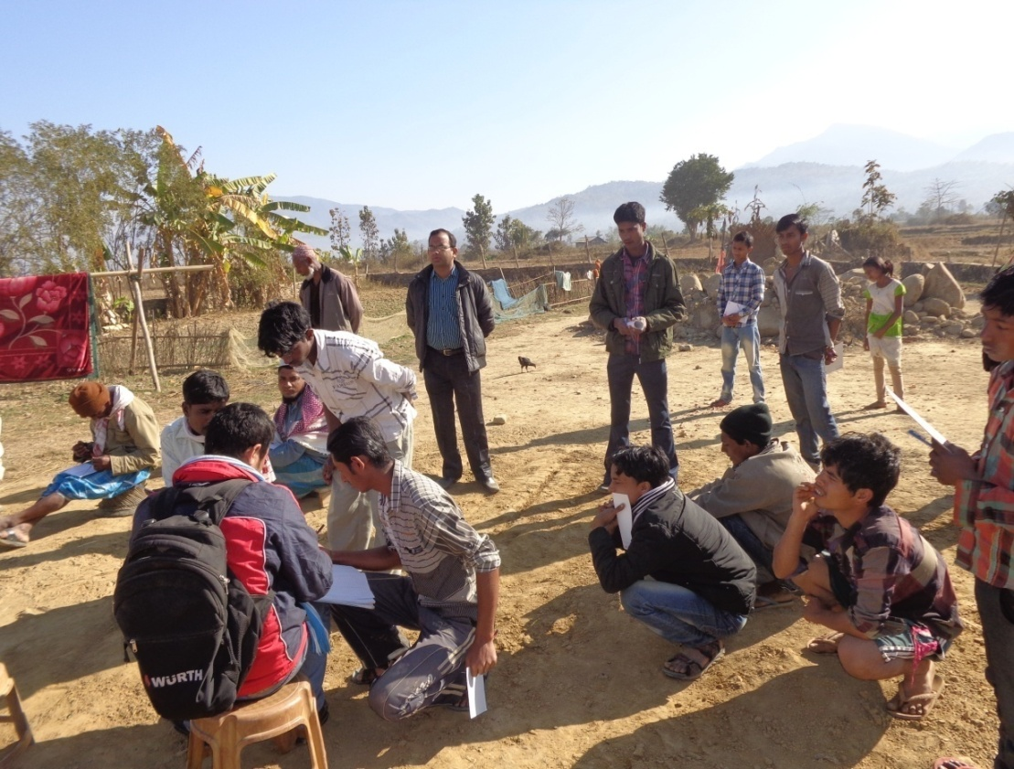
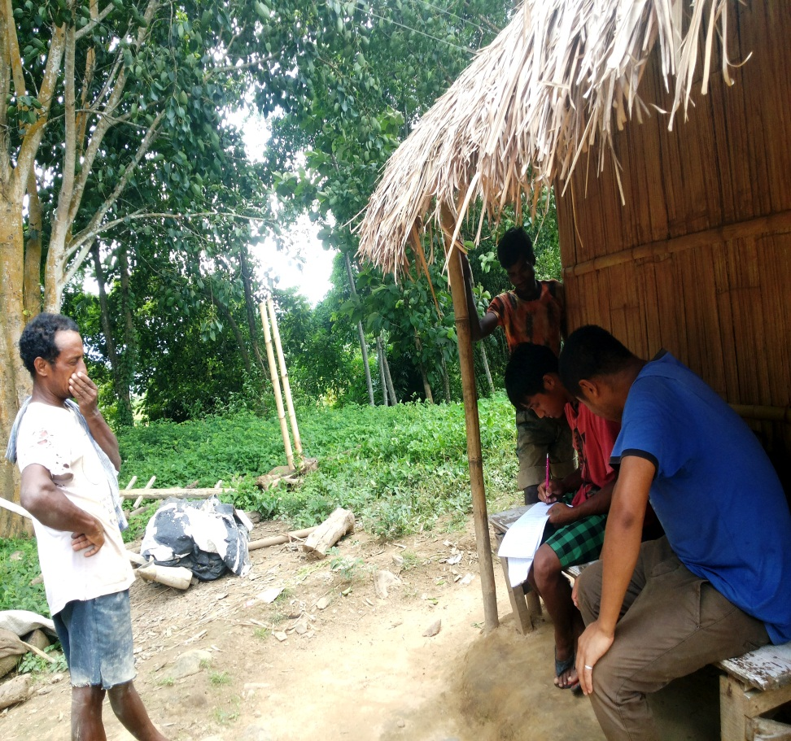
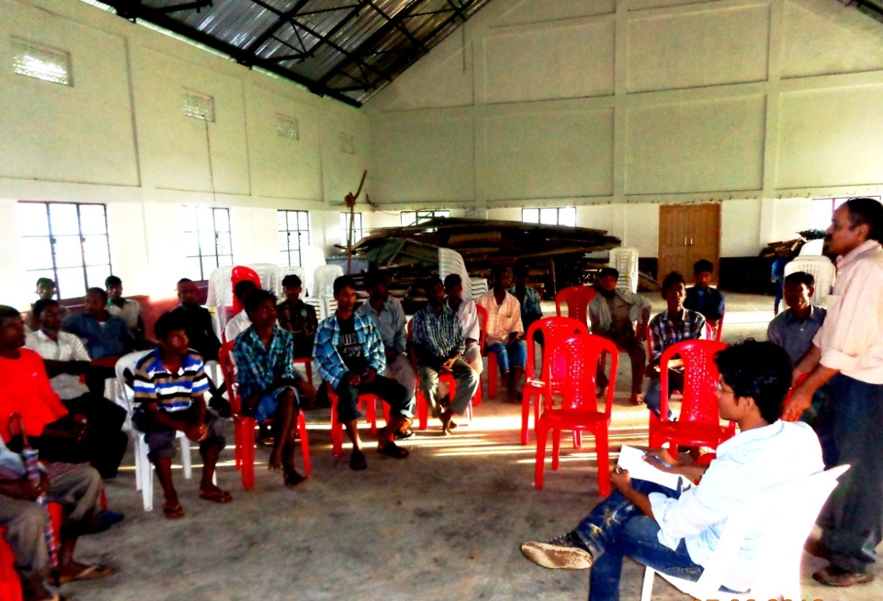
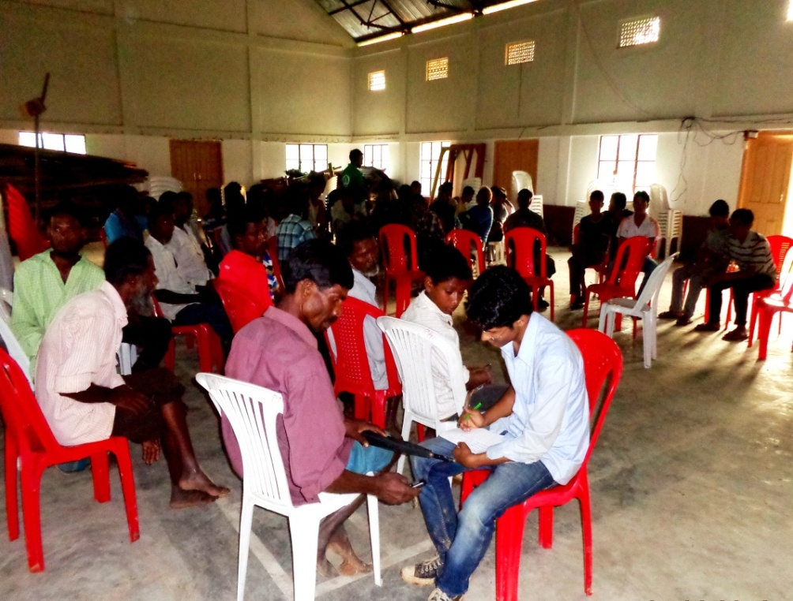

Slide 27
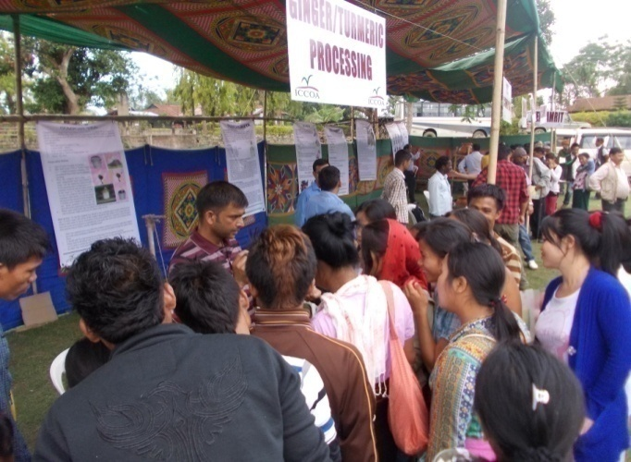
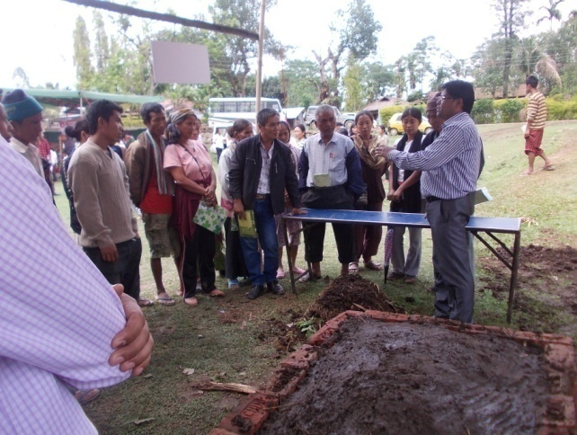
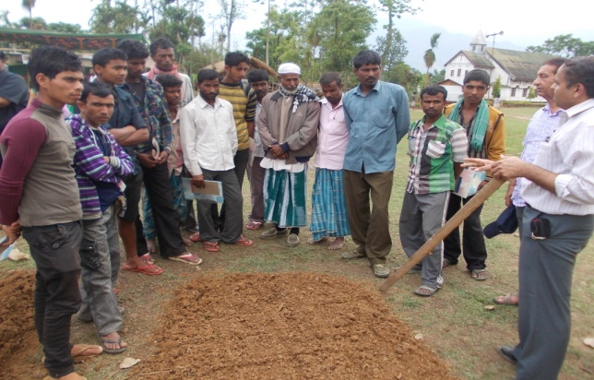
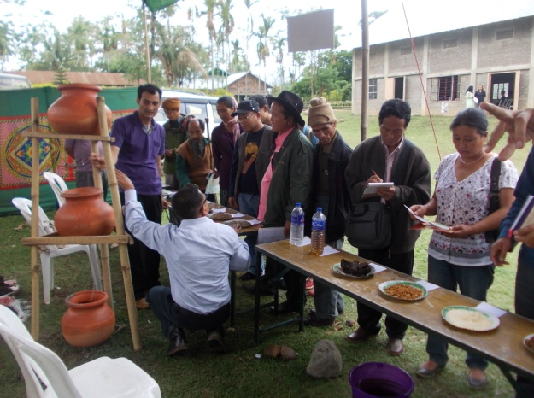
DEMONSTRATIONS IN VILLAGE

Slide 28
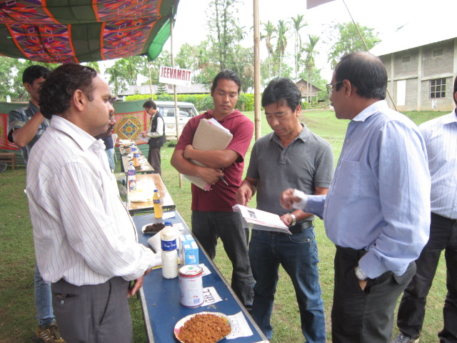
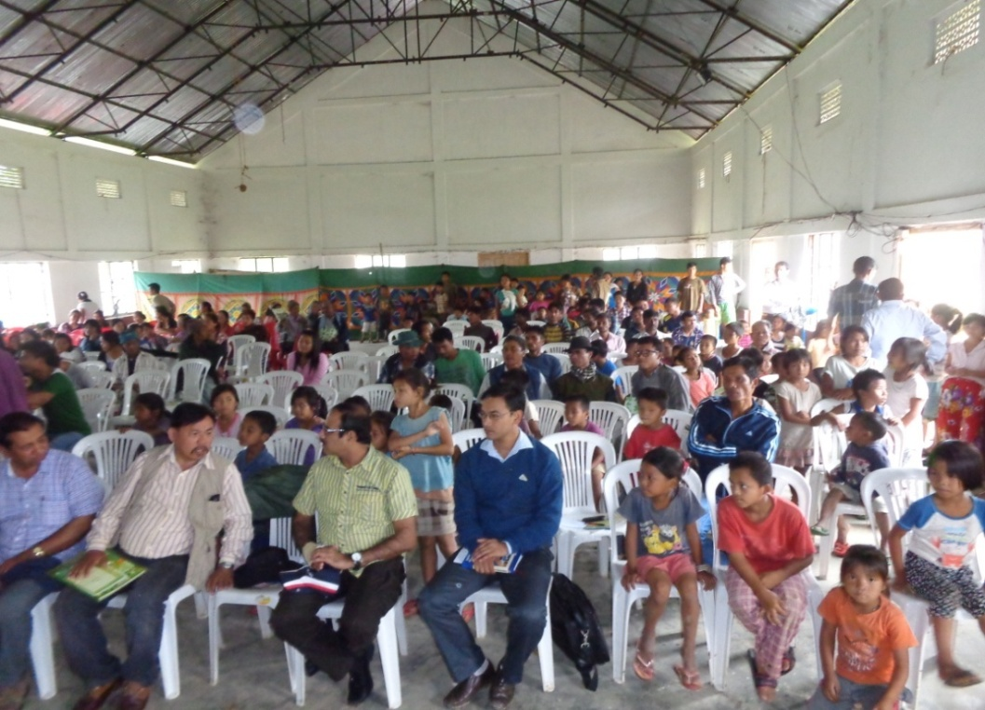
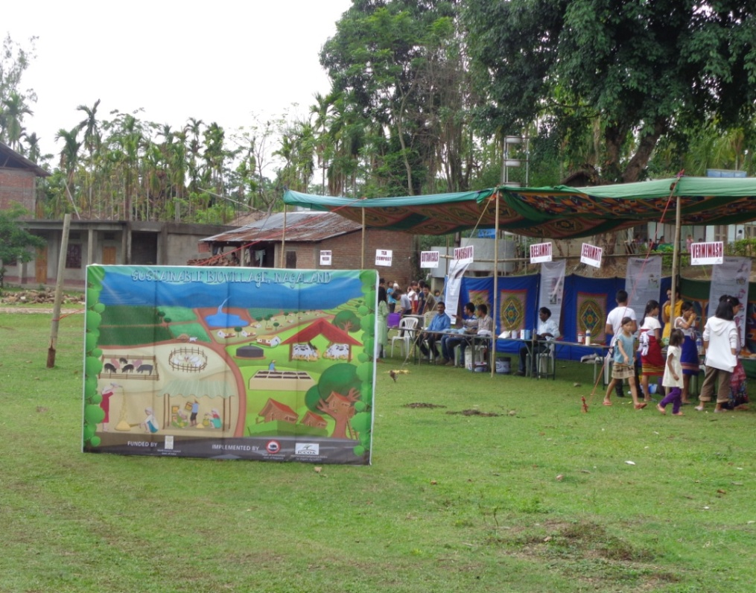
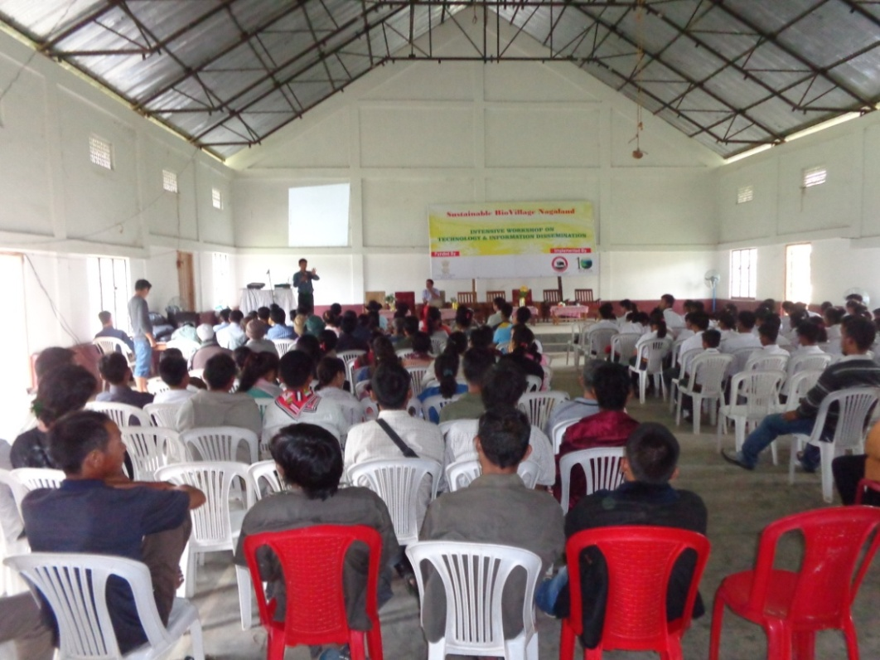

Slide 29
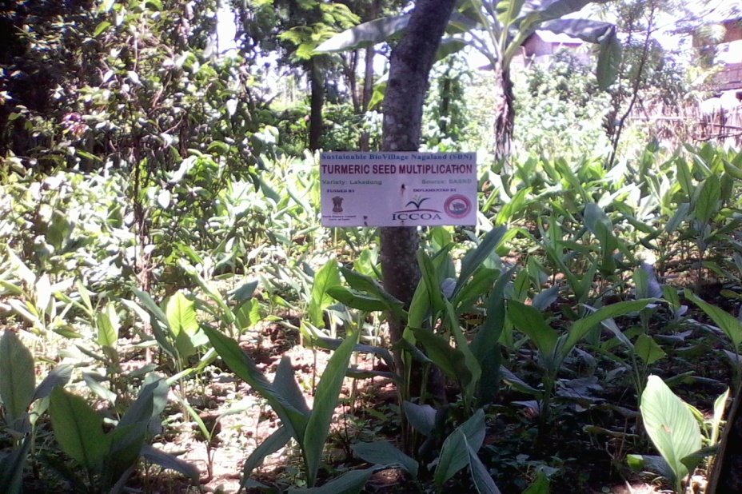

SEED VILLAGE
BADE VILLAGE -
– TURMERIC

Slide 30




TURMERIC SEED MULTIPLICATION

Slide 31




MARKETING INITIATIVE – TURMERIC

Slide 32




MARKETING INITIATIVE – PINEAPPLE

Slide 33


MONITORING BY COMMITTEE

Slide 34




VISIT OF TOURISTS/OFFICIALS
Nagaland Organic Pineapple Farming- video.flv

Slide 35
Strategies for Promotion of Bio Villages
Create successful model – To propagate and replicate across regions
Make local government understand holistic benefits of Bio villages and
integration of support schemes
Create local leaders/ entrepreneurs in local governance/village levels
Collate best indigenous practices and introduce in other project
areas as part of innovation and recognition of those practicing it.
Continuous improvement of best practices across organic value chain.
To constitute state level task force – identify villages per district for bio
village

Slide 36
Ultimately leading to:
Sustainability in Agriculture: Ecological, Social and Economic sustainability
Encourage Rural Entrepreneurship
Promote Agri Eco Tourism
Make Local Govts actively involved in Organic and Sustainable agriculture

Slide 37

THANK YOU ALL
WELCOME TO NAGALAND

